Slide 1
Homebrew Wireless Antenna Switcher
2026.08.19
KQ4TIV

Slide 2
Statement of Problem
Synopsis
Requirements
Needing remote switching capability to select from multiple antennas for different purposes on HF. Did not want to dig or lay wires from shack which was over 250 feet away. Had to be self sufficient and low maintenance. Also did not want to have separate coax runs ($$$) to each antenna.
Wireless
Reduce amount of coax
Low maintenance
Does not require constant voltage source
Customizable
Notes:
I had a specific need and wanted a specific solution. I could not find what I wanted on the market that ticked all my boxes, and I also have the XYL to keep happy too. Most solutions relied on electrical relays which requires constant voltage, making the power usage quite wasteful and increases the cost of power equipment.

Slide 3
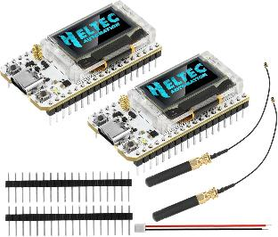
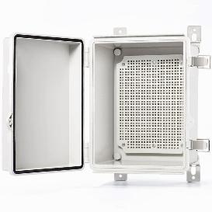
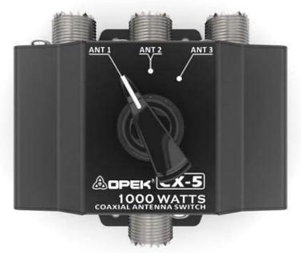
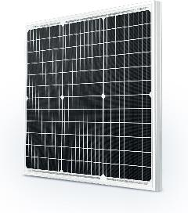
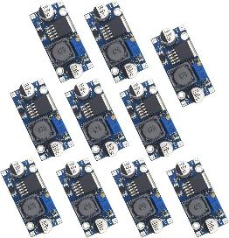
Equipment
$40 Amazon Link
$22 Amazon Link
$54 Amazon Link
$1.30 Amazon Link
$43 Amazon Link
Total minus battery and cables = $160.30
For comparison:
* 250ft of KMR400 = $156.25
* Commercial options I found = $400-600 minimum
Notes:
After looking at what I had on hand already (Heltecs, solar panel, battery, cabinet) I came up with this solution.

Slide 4
Setup
Solar Panel
12V Bat
Radio
←250ft→
Cabinet
Fan Dipole
DC-DC Downconverter
PC
Rotating Switch
Butternut
Heltec Outside
Servo
Heltec Inside
192.168.1.30
Testing
Notes:
The inside heltec runs the server on the microcontroller itself and sends commands to the outside heltec. The outside heltec receives the commands, sends commands to the servo which rotates the antenna switch to the desired antenna, then the heltec sends a confirmation back to the inside heltec. The battery supplies voltage through a step down converter to both the heltec and the servo. Servo does not use any power when idle, and the heltec requires approximately 60mA when idle.

Slide 5
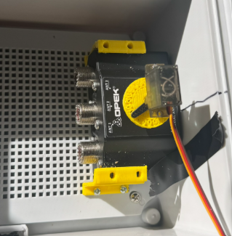
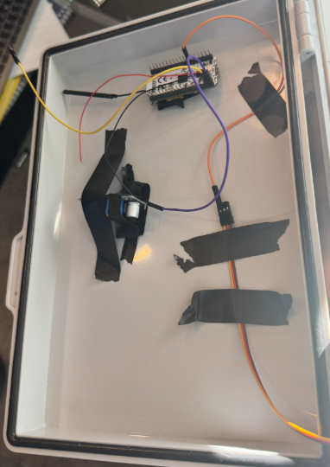
Construction
1
Picture 1 shows the switch mounted to inside of case using 3d printed mounts and the servo attached to the rotor of the switch with a 3d printed mount
Picture 2 shows heltec, wiring, and buck converter mounted to inside of door during testing
2

Slide 6
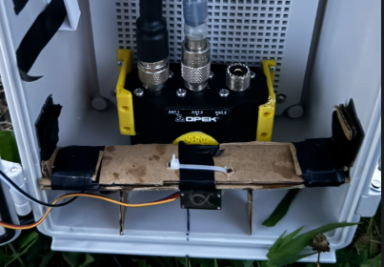
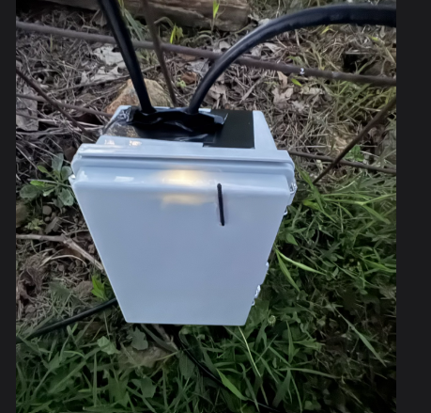
Construction
Picture 3 shows a prototype mount used to hold servo in place. This proved too restrictive and was replaced with a different prototype 3d printed mount
Picture 4 shows the lora antenna through the door with the proof of life led shining through
3
4

Slide 7
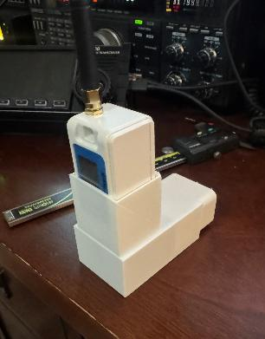
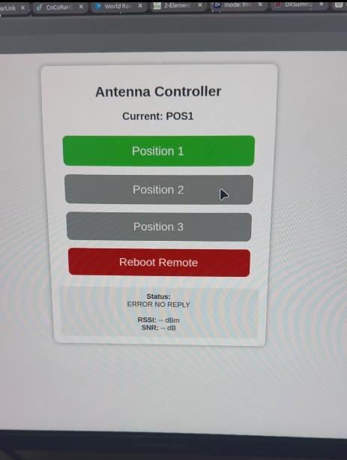
Construction
Image 5 shows the inside heltec in case with 5v power block. This allows it to be plugged into any outlet and be powered and run out of the away somewhere else in the house
Image 6 shows the control software interface that runs on a webserver programmed into the inside heltec
5
6

Slide 8
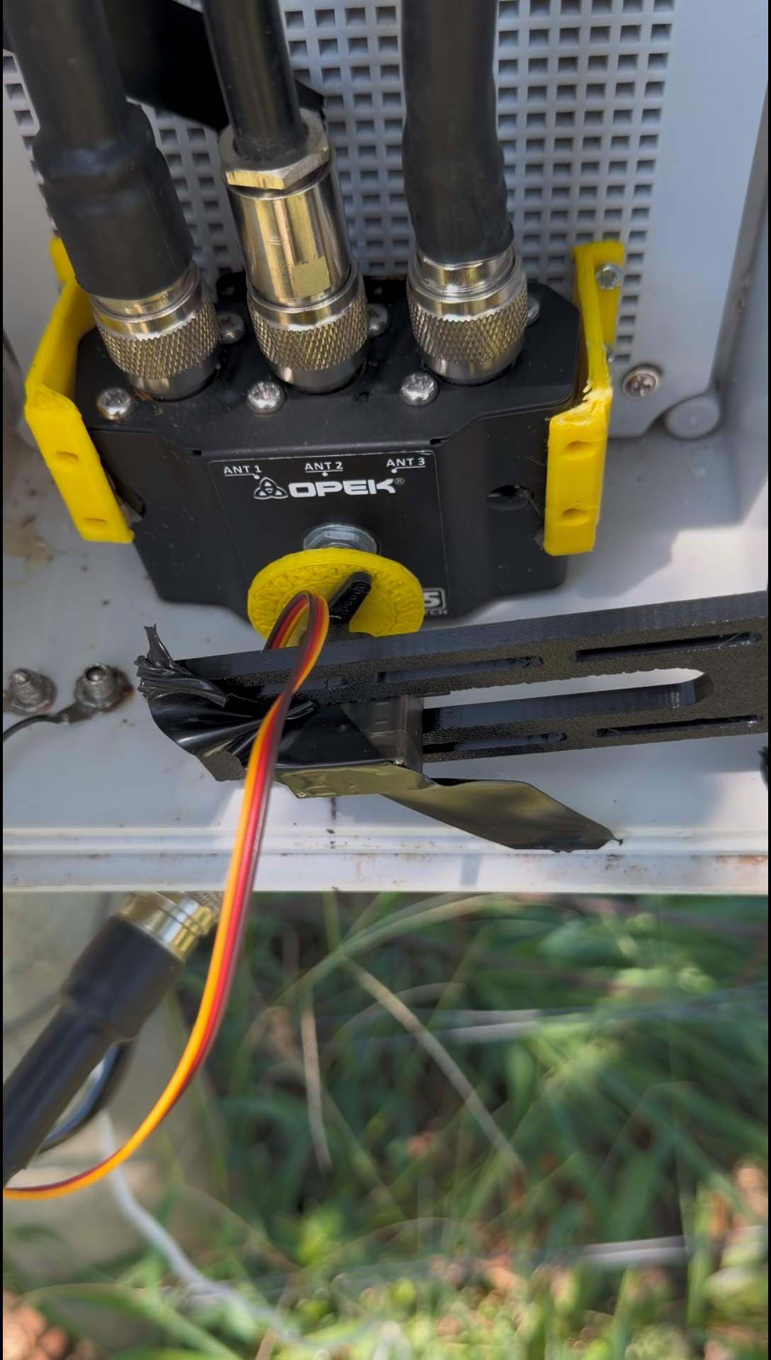
Output and Open Items
Web interface needs work:
Buttons don’t always switch colors
Feedback is not always displayed properly on webpage leading you to not know exactly which antenna is active
Clean up cabinet
Add cover over coax wires for water intrusion

Slide 9
Questions?

